Slide 1
edU: Iteration 2
Zachery Gentry, Tousar Mohammed, Giannina Pachas and Courtney Howland

Slide 2

Vision Statement Reminder
We are creating a multi-platform mobile app which focuses on image recognition capabilities in an educational environment.

Slide 3
Overview
Xcode
Firebase ML Recognition
-Benefits
New Risk
Main Success Scenario and extension
Addressing the review team
Demo

Slide 4
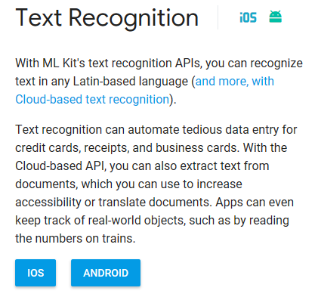
Firebase ML Recognition
(Picture 1)

Slide 5
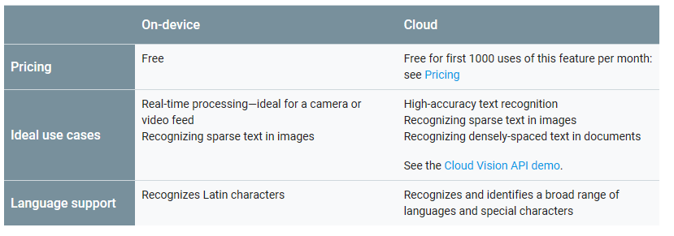
Benefits
(Picture 2)

Slide 6
New Risk
Risk : The team is is switching platforms to Native IOS because React Native is unpredictable and easily crashes even with minor changes.
Risk Exposure: RE = 100% * 12hr = 12hr
Solution: The team will split up the work among the members to increase the success of transferral.

Slide 7
Main Success Scenario and extension
Main Use Case: Drawing pad
Main Success Scenario
The user is prompted to draw an letter, number or shape for validation.
The User draws the image on the drawing pad
The User submits the drawing.
The System takes a screenshot
The System validates the image.
The System displays a message:
Correct!
Incorrect! Try Again!
Congrats!
Extension
User draws a incoherent image or draws nothing when submitting an image.
The System will display the "incorrect! Try Again!" message
The System will start back at step a.

Slide 8

Addressing the Review Team
Question 1: It is stated that the user will hear the lesson plan to know what’s the goal, will the screen have a button to press to show it visually on screen in text in case user has phone speaker problems?
The team will have a Lesson zero. This lesson will show all the images needed to learn the material.
(Picture 3)

Slide 9
Addressing the Review Team cont...
Question 2: If you guys are deploying the app on app store/google play, how will the cost of the API will be handled ? Because after certain time amazon's free tier ends, and amazon charges money for the usage of AWS.
The team has decided to use Firebase ML text recognition at the moment and it is free for the teams purposes.
Question 3: It seems the application relies heavily on network connectivity. What happen if user loses the connection while using the app. Will they be able to continue working on the drawing and save their progress data on local devices (caching)?
The app does not rely on network connectivity, everything is done locally in the app.

Slide 10
Resources
https://pixabay.com/en/nature-green-natural-green-leaves-3337499/(Picture 1 & 2)
https://firebase.google.com/docs/ml-kit/recognize-text
http://www.pcyc.org.au/Clubs/Redlands/Basketball/Juniors.aspx (Picture 3)

Slide 11
Demo

